Slide 1
Simulation of PbS Quantum Dots
Group Project by Matthias Dittberner and Christian Funck

Slide 2
Overview
MATLAB Toolbox for QD-Simulations with OMEN
Genneral idea
Demo
PbS QD Simulations with OMEN
Simulation Data:
Analysis
Comparison with experimental data
Poster
Documentation

Slide 3
TOM: Toolbox for OMEN in MATLAB
Simulation:
Starting simulations intuitively and efficiently via GUI
Automatically generate different parameter combinations
Managing the simulation data:
Overview over previous simulations
Filtering, deleting etc. possible
Visualisation of simulation data
Different functions for plotting (wave functions, energy levels...)

Slide 4
TOM: Toolbox for OMEN in MATLAB
Easy to use
Well documented
Generic and clear structure: additional functionality can easily be added (new simulation parameters, plotting functions...).
Short Demo with some principal features

Slide 5
Simulation of PbS QDs with OMEN
PbS structures can now be simulated with OMEN
(Tight-binding parameters from Craig Lent-Paper)
Things to note for PbS QD simulations:
Computing resources: PbS uses much more resources compared to CdS-CdSe (memory and duration). Reasons:
Number of orbitals (18 for PbS vs 5 for CdS-CdSe)
Number of modes (see below)
More modes have to be simulated, due to high degeneracy of the energy levels.

Slide 6
Analysis of Simulation Data
Simulated QDs:
Radius between 0.5 and 5 nm
Electric fields up to 2V/nm
20 modes for CB and VB respectively

Slide 7
Band gap: dependence on size of QD
1/r² –fit: estimated bulk band gap ~0.42 eV: Too big compared to the experimental value of 0.37eV
Deviation from 1/r² dependence for small QDs

Slide 8
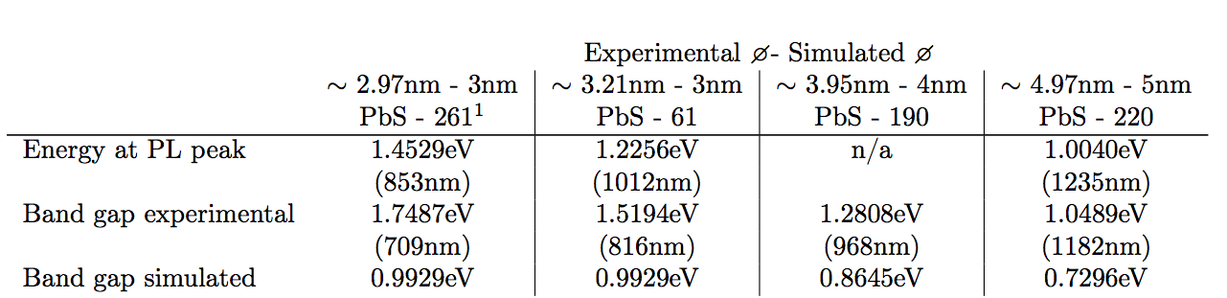
Band gap: comparison with experimental data
Generally: Correct tendency, but simulated band gap much smaller than suggested by absorption spectra of PbS QDs. Possible reasons:
Real QDs are not perfect: impurities, non uniform size ...
Simulation parameters
Size: correctly determined the size from TEM images? (see next slide)

Slide 9
Band gap: comparison with experimental data
Possible issue: The size of the QDs is difficult to determine...

Slide 10
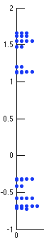
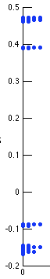
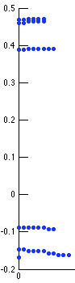
Energy levels for PbS QDs
Band edges: 8 quasi degenerate energy levels.
2nm QD
10nm QD
10nm QD, better visibility for (quasi) degenerate states.

Slide 11
Wave functions for band edge states, big QDs
Spherical shape: „1S orbitals“
Probability density for a CB state near band edge, of a 8nm QD.

Slide 12
Wave functions for higher modes
Non spherical shapes: Probability density for CB modes 10, 14, 20.

Slide 13
Wave functions for small QDs
Near band edge states: spherical symmetry of wave fn is lost for some states.
Close to reality?
Probability density for CB mode 3 of a 2nm QD.

Slide 14
Energy levels and electric field
Energy levels for a 5nm QD plotted against applied electric field.
Band gap gets smaller for higher fields.
8-fold degeneracy of band edge states is lost (twofold degenerate states remain).

Slide 15
Wave functions and electric field
Shift of wavefunction, depending on hole-like resp. electron-like character, to the left or right.

